Slide 1



sample superstore profit report
View in Power BI
Last data refresh:
6/13/2022 10:48:39 PM UTC
Downloaded at:
6/13/2022 10:50:37 PM UTC

Slide 2
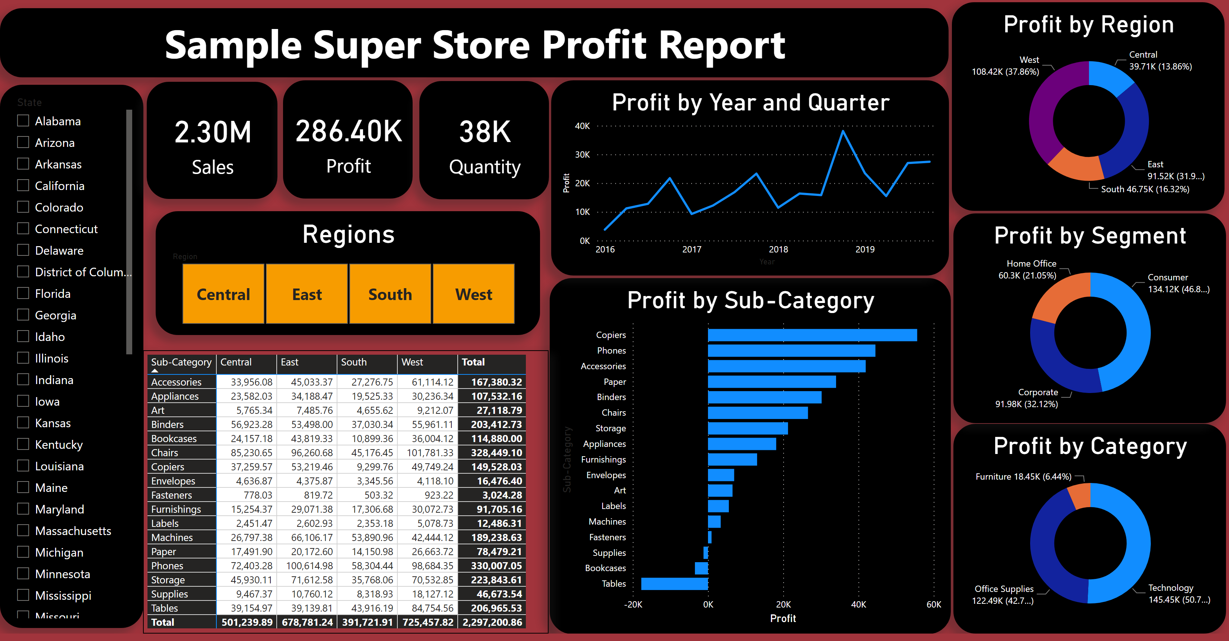
Page 1
Notes:
donutChart
No alt text provided
donutChart
No alt text provided
donutChart
No alt text provided
Sample Super Store Profit Report
No alt text provided
clusteredBarChart
No alt text provided
lineChart
No alt text provided
slicer
No alt text provided
card
No alt text provided
card
No alt text provided
card
No alt text provided
pivotTable
No alt text provided
Regions
No alt text provided

Slide 3
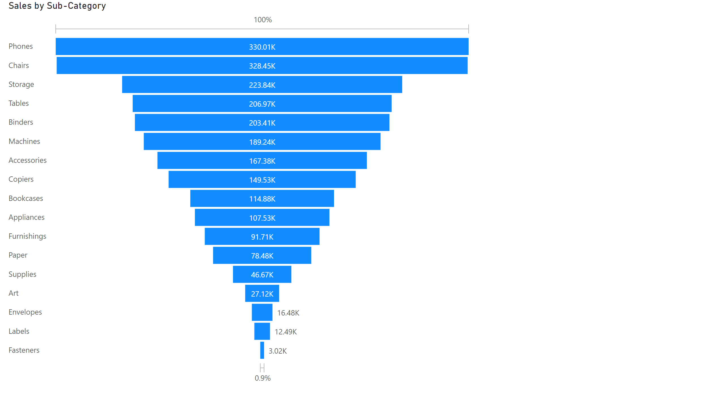
Page 2
Notes:
funnel
No alt text provided

